Slide 1
CS 5402 Introduction to Data Mining
Regression
v.1.1
Perry B. Koob, koobp@mst.edu

Slide 2
What we are going to learn.
Linear Models
Simple Linear Regression
R² and adjusted R²
Multiple Linear Regression
Model Building

Slide 3
Numeric Prediction
4 Types of Learning
Classification Learning
Association Learning
Clustering
Numeric Prediction
Numeric Prediction is learning where the outcome is a numeric value and not a class.
The input for Numeric Prediction is generally Interval or Ratio, but on occasion can be Nominal or Ordinal.
Nominal and Ordinal data has to be transformed. Pay attention to Nominal data with Numeric labels.

Slide 4
Classification vs. Numeric Prediction
Input: (Attributes)
Nominal and Ordinal data attributes.
Ratio and Interval data attributes with discretization.
Output: (Class)
Input: (Predictor variables or Factors)
Ratio and Interval data attributes.
Nominal and Ordinal data attributes with transformation.
Output: (Response variable)
Numeric Value

Slide 5
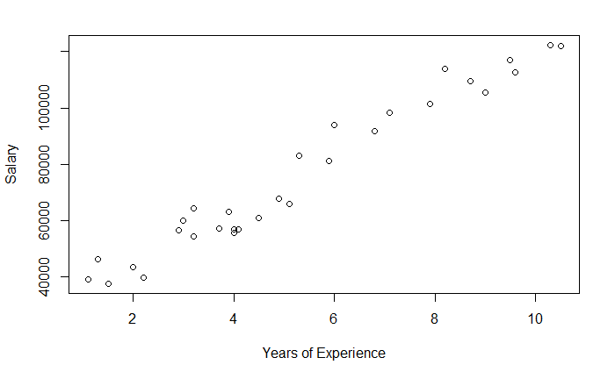
Linear Models - Linear Data
The Scatter Plot shows a clear linear relationship.

Slide 6
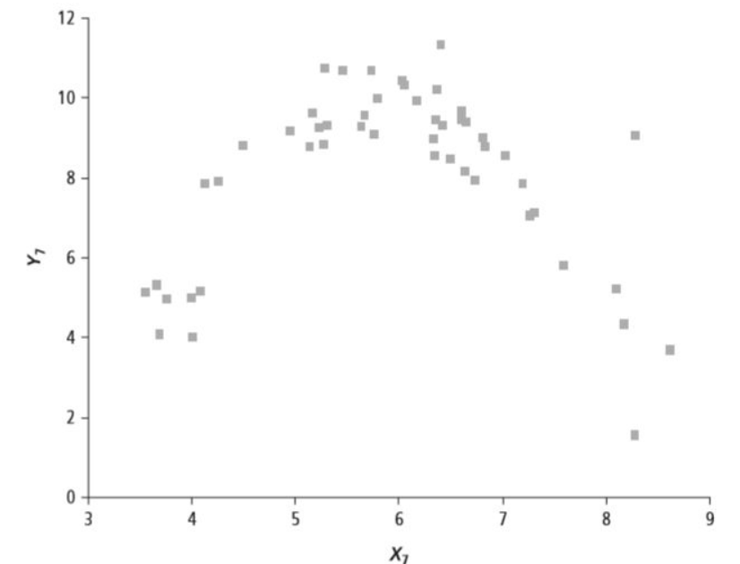
Linear Models - Non-Linear Data
The Scatter Plot shows a clear parabolic, non-linear relationship.
https://www.quora.com/What-does-it-mean-if-a-linear-correlation-coefficient-is-close-to-zero

Slide 7
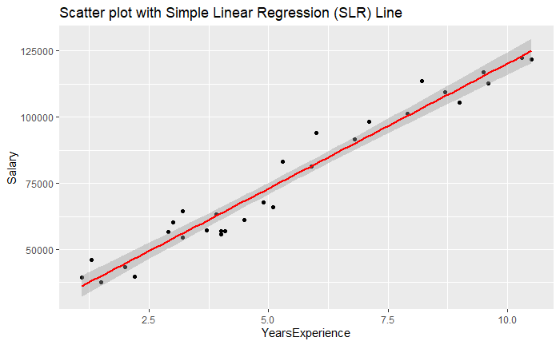
Linear Models

Slide 8
Linear Models
You can see that the data looks linear from the scatter plot.
We can model this using the formula for a line…
Y = m*x +b
b = the y intercept
M = the slope

Slide 9
Linear Models
In some cases we can model this using the formula for a line…
Y = m * x + b
m = the slope
b = the y intercept
So our data will be between 1 predictor, x , and 1 response, y.
For only 1 predictor, x, this is called Simple Linear Regression.

Slide 10
Linear Models
In other cases we can model this using the formula for a hyperplane…
Y = m₁ * x₁ + m₂ * x₂ +... m_{n} * x_{n} + b
m = the slope
b = the y intercept
So our data will be between multiple predictors, x₁...x_{n}, and 1 response, y.
For more than 1 predictor, x₁...x_{n}, this is called Multiple Linear Regression.

Slide 11
Linear Models
Ordinary Least Squares (OLS)
Regression technique which seeks to minimize the Sum of Squared Errors of the prediction.
Simple Linear Regression (SLR)
OLS between one predictor and one response.
Multiple Linear Regression (MLR)
OLS between multiple predictors and one response.

Slide 12
Linear Models

Slide 13
Linear Models
We get values from our model by plugging in our predictor values and getting a response values from the function.

Slide 14
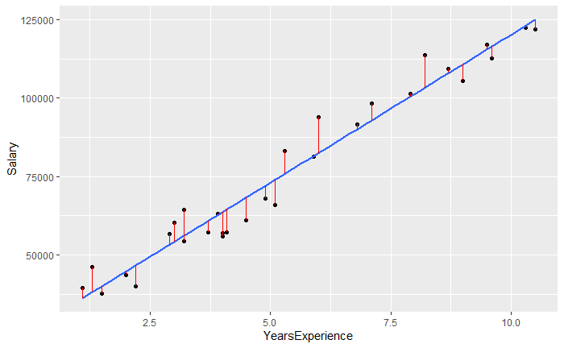
Linear Models
Actual data points

Slide 15
Linear Models
Fitted line.

Slide 16
Linear Models
Error of the Prediction or Residuals, is the difference between the actual and predicted values.

Slide 17
Simple Linear Regression
Y = β₀+ β₁ * x₁+ Ɛ
β₀ = the y intercept
β₁ = the coefficient of x₁
x₁ = the predictor, factor, or independent variable
Y = the response, or dependent variable
Ɛ = Error term

Slide 18
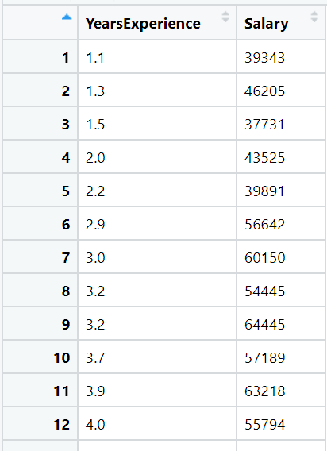
Simple Linear Regression

Slide 19
Simple Linear Regression - R
train <- read.csv(file = '../src-data/Salary_Data_train.csv',stringsAsFactors=TRUE)
linearModel <- lm(Salary ~ YearsExperience, data=train)
linearModel
Call:
lm(formula = Salary ~ YearsExperience, data = train)
Coefficients:
(Intercept) YearsExperience
25792 9450

Slide 20
Simple Linear Regression - R
train <- read.csv(file = '../src-data/Salary_Data_train.csv',stringsAsFactors=TRUE)
linearModel <- lm(Salary ~ YearsExperience, data=train)
linearModel
Call:
lm(formula = Salary ~ YearsExperience, data = train)
Coefficients:
(Intercept) YearsExperience
25792 9450
β₀
β₁

Slide 21
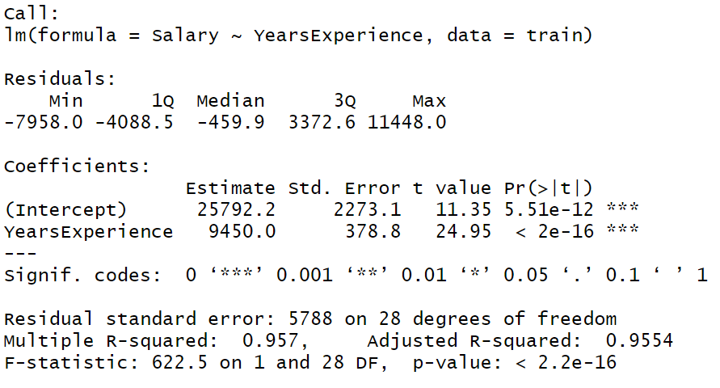
Simple Linear Regression - R
summary(linearModel)

Slide 22
Simple Linear Regression - R
Measure of how close the data is to the regression line.
For SLR we can use R². Also called the Coefficient of Determination. For SLR Multiple R² = R²
For MLR we use Adjusted R².
summary(linearModel)

Slide 23
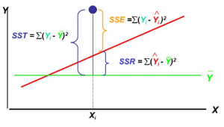
Simple Linear Regression - R
SSE
R² = 1 - _____
SST
SSE = Sum of Squared Errors of the Prediction
SSR = Sum of Squared Regression values
SST = Sum of Squared Totals; SSR + SSE
(1 - R₂)(N - 1)
Adjusted R2 = 1 - ___________
N - p - 1
p = Number of predictors
N = Sample size
https://vitalflux.com/linear-multiple-regression-interview-questions-set-4/

Slide 24
Simple Linear Regression - Python
import pandas as pd
import statsmodels.api as sm
train = pd.read_csv("..\\src-data\\Salary_Data_train.csv")
x = train["YearsExperience"]
x = sm.add_constant(x)
y = train["Salary"]
model = sm.OLS(y, x).fit()
predictions = model.predict(x)

Slide 25
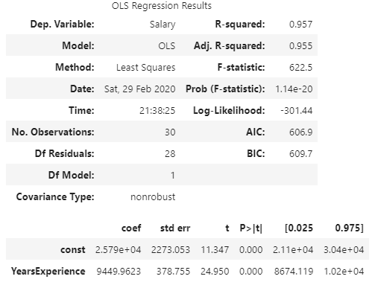
Simple Linear Regression - Python
model.summary()

Slide 26
Simple Linear Regression - Python
HIGH R-squared and Adj. R-squared tells us we account for most of the variance in the model. So it is GOOD model.
model.summary()
LOW P-Value tells us that there is no evidence to reject the attribute as an attribute of the model. So they are GOOD attributes.
This is a hypothesis test to determine if there is a relation between the predictor and the response variable.
With SLR rejecting the attribute is rejecting the model.

Slide 27
Simple Linear Regression - Python
model.summary()
β₀
β₁

Slide 28
Simple Linear Regression
We can use the function from our model
Y = 2579 + 9449.9623 * x
to get prediction values.

Slide 29
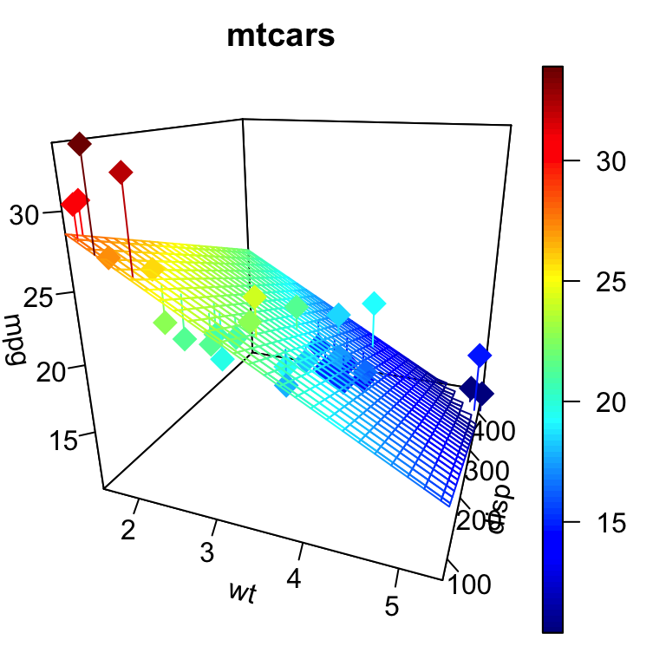
Multiple Linear Regression
Y = β₀+ β₁ * x₁+ β₂ * x₂+ β₃ * x₃+ β₄ * x₄+ …+ β_{n} * x_{n}+ Ɛ
β₀ = the y intercept
β₁ = the coefficient of x₁
x_{i} = the predictors, factors, or independent variables
Y = the response, or dependent variable
Ɛ = Error term
http://www.sthda.com/english/wiki/impressive-package-for-3d-and-4d-graph-r-software-and-data-visualization

Slide 30
Multiple Linear Regression - Assumptions
Assumptions:
The relationship is linear.
Residuals are normally distributed.
Residuals have constant variance.
Attributes are independent.

Slide 31
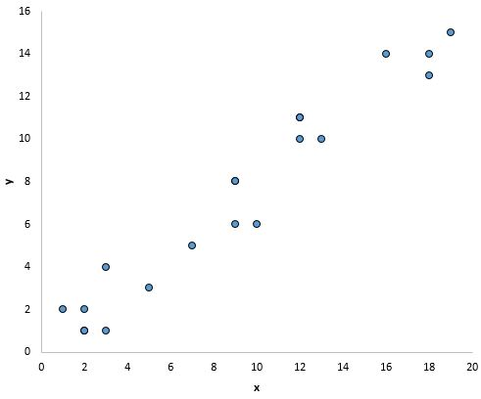
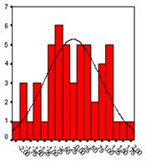
Multiple Linear Regression - Assumptions
Assumptions:
The relationship is linear.
Residuals are normally distributed.
Residuals have constant variance.
Attributes are independent.
https://www.statology.org/linear-regression-assumptions/
https://www.statisticssolutions.com/assumptions-of-linear-regression/

Slide 32
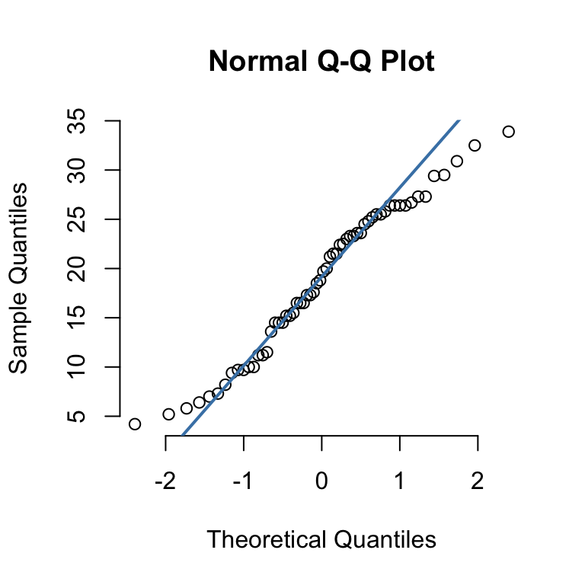
Multiple Linear Regression - Assumptions
Assumptions:
The relationship is linear.
Residuals are normally distributed.
Residuals have constant variance.
Attributes are independent.
http://www.sthda.com/english/wiki/qq-plots-quantile-quantile-plots-r-base-graphs

Slide 33
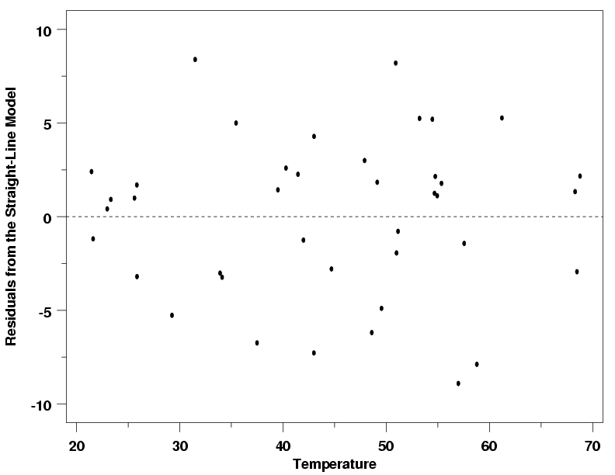
Multiple Linear Regression - Assumptions
Assumptions:
The relationship is linear.
Residuals are normally distributed.
Residuals have constant variance.
Attributes are independent.
https://www.itl.nist.gov/div898/handbook/pmd/section4/pmd442.htm

Slide 34
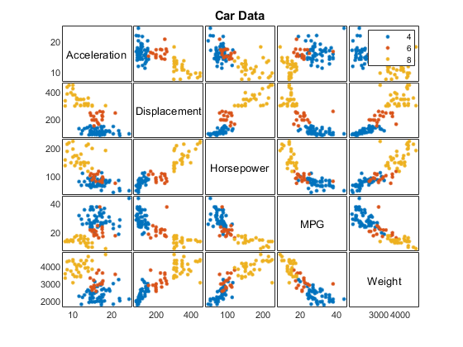
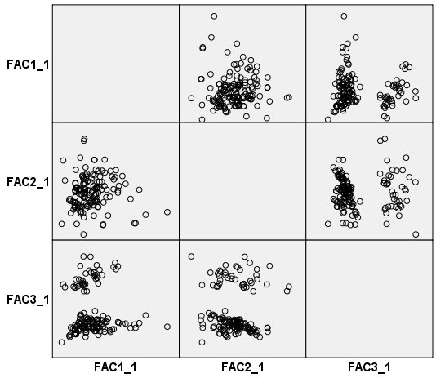
Multiple Linear Regression - Assumptions
Assumptions:
The relationship is linear.
Residuals are normally distributed.
Residuals have constant variance.
Attributes are independent.
https://www.mathworks.com/help/stats/gplotmatrix.html
https://www.ibm.com/support/knowledgecenter/SSLVMB_24.0.0/spss/tutorials/fac_cars_fscorescatter.html

Slide 35
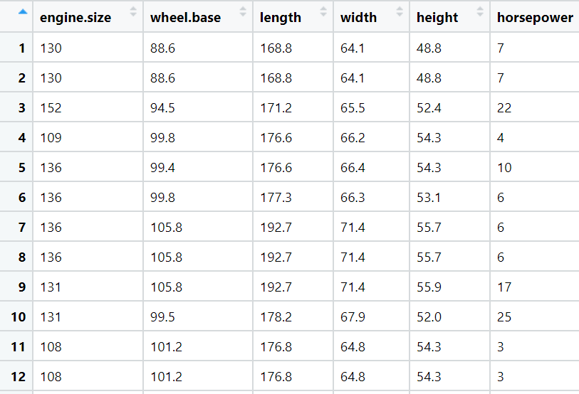
Multiple Linear Regression

Slide 36
Multiple Linear Regression - R
train <- read.csv(file = '../src-data/imports-85-train.csv',stringsAsFactors=TRUE)
train$horsepower <- as.integer(train$horsepower)
train$price <- as.integer(train$price)
linearModel <- lm(price~engine.size + wheel.base + length + width + height +
horsepower, data=train)

Slide 37
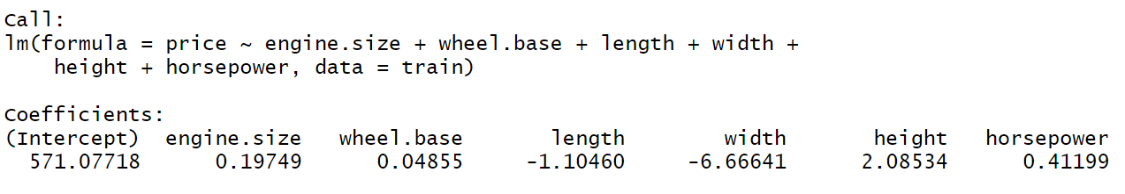
Multiple Linear Regression - R
linearModel
The linear model generates a function like this. This function represents a hyperplane.
y = 571.07718 + 0.19749 * x₁ + 0.04855 * x₂ - 1.10460 * x₃ - 6.66641 * x₄ + 2.08534 * x₅ + 0.41199 * x₆

Slide 38
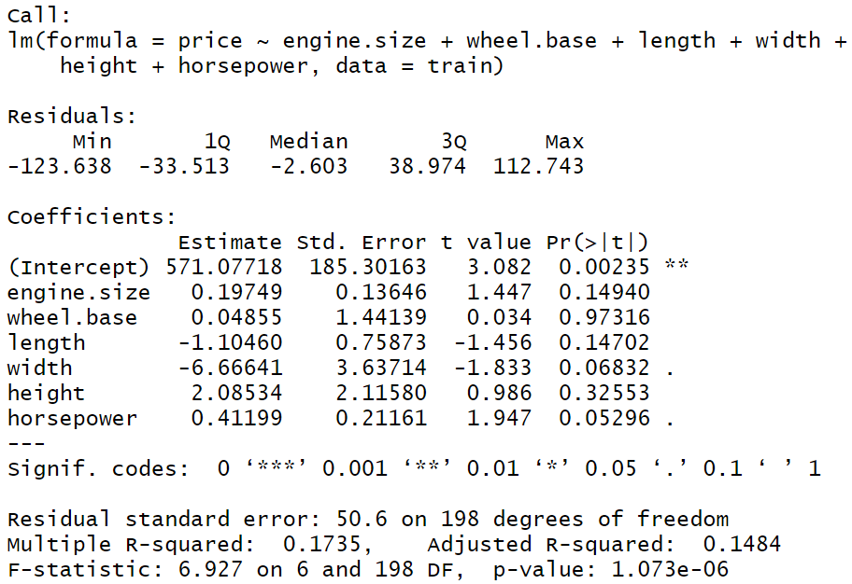
Multiple Linear Regression - R
Measure of how close the data is to the regression line.
We want this number to be large.
For MLR we use Adjusted R².
summary(linearModel)

Slide 39
Multiple Linear Regression - R
These values are p-values.
This is a hypothesis test to determine if there is a relation between the predictor and the response variable.
This is one of the reasons we have those assumptions.
summary(linearModel)

Slide 40
Multiple Linear Regression - R
Measures how much the predictor explains the variance in the response.
A value close to 0 is GOOD. This means we reject the null hypothesis that there is no relation between the predictor and the response.
summary(linearModel)

Slide 41
Multiple Linear Regression - R
Measures how much the predictor explains the variance in the response.
A value close to 1 is BAD. This means we fail to reject the null hypothesis that there is no relation between the predictor and the response.
summary(linearModel)

Slide 42
Multiple Linear Regression - R
When we find a high p-value like this, we may consider removing the predictor an re-running the model.
summary(linearModel)

Slide 43
Multiple Linear Regression - R
When we find a high p-value like this we may consider removing the predictor and re-running the model.
summary(linearModel)

Slide 44
Multiple Linear Regression - Python
import pandas as pd
import statsmodels.api as sm
data = pd.read_csv("..\\src-data\\imports-85-train.csv")
train = data[data['price']!= '?']
x = train[['engine-size','wheel-base','length','width','height']].astype(float)
x = sm.add_constant(x)
y = train["price"].astype(float)
model = sm.OLS(y, x).fit()
predictions = model.predict(x)
model.summary()

Slide 45
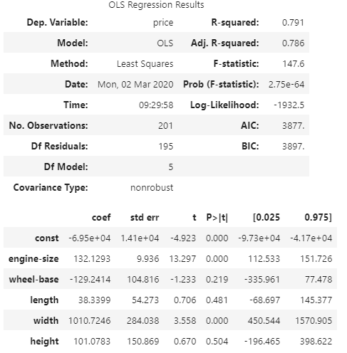
Multiple Linear Regression - Python

Slide 46
Model Building
Picking which predictors to use in your model is called model building. There are three common model building methods:
Forward Selection - you start with no predictors and evaluate each predictor one at a time for inclusion into your model.
Backward Elimination - you start with all possible predictors and evaluate each predictor one at a time for removal from you model.
Stepwise - Forward Selection where each predictor is evaluated for inclusion and exclusion.

Slide 47
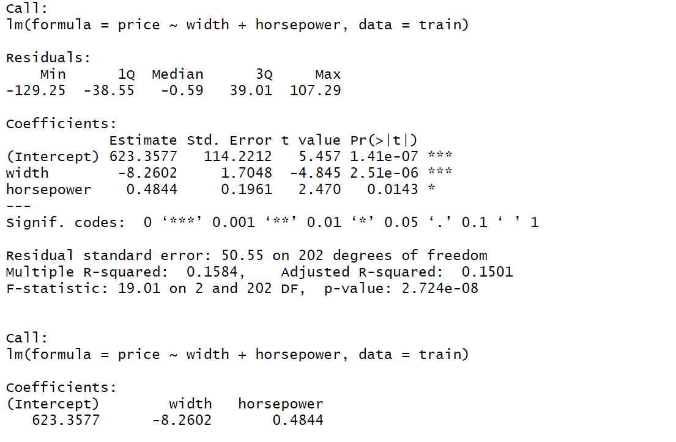
Multiple Linear Regression - Assumptions...

Slide 48
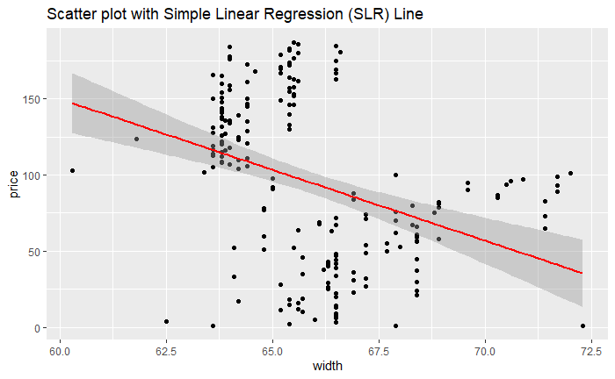
Multiple Linear Regression - Violated Assumptions

Slide 49
What we covered.
Linear Models
Simple Linear Regression
R² and adjusted R²
Multiple Linear Regression
Model Building

Slide 50
What to learn more?
For Regression take CS 5204 / STAT 5346

Slide 51
References
Kassambara, Realstack, Visitor, & Mann, T. (2018, March 11). Linear Regression Assumptions and Diagnostics in R: Essentials. Retrieved from http://www.sthda.com/english/articles/39-regression-model-diagnostics/161-linear-regression-assumptions-and-diagnostics-in-r-essentials/
Shmueli, G., Bruce, P. C., Yahav, I., Patel, N. R., & Lichtendahl Jr, K. C. (2017). Data mining for business analytics: concepts, techniques, and applications in R. John Wiley & Sons.
Witten, I. H., Frank, E., Hall, M. A., & Pal, C. J. (2016). Data Mining: Practical Machine Learning Tools and Techniques.

